Slide 1
The Great War
US Entry & the Modern Warfare of

Slide 2
American Neutrality
Refusal to take part in the war
For 3 years, America remained neutral
Strong feelings not to get involved in a European War
Why join a struggle 3,000 miles away?
The war did not threaten American lives or property
“Every man who really loves America will act and speak in the true spirit of neutrality…” –Woodrow Wilson
…until…

Slide 3
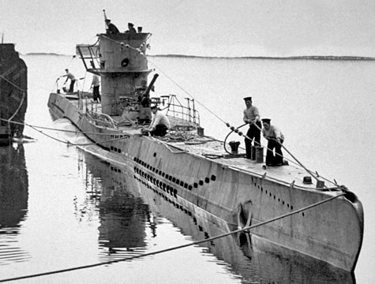
Submarine Warfare
German “U-Boats” or Unterwaserboot (undersea boat)
Germany wanted to prevent war supplies from reaching Britain and claimed the waters around England as a “war zone”
Any enemy or merchant ship found in waters around Britain would be sunk without warning

Slide 4
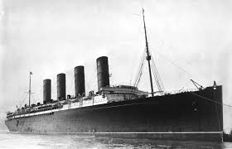
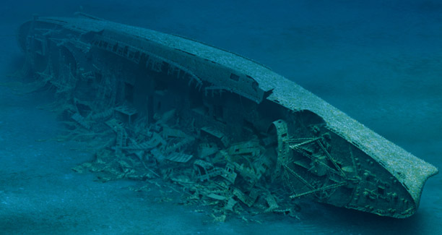
The Sinking of the Lusitania
British passenger liner Lusitania left NYC for England despite warnings of active u-boats
May 7, 1915: Lusitania sinks, killing 1,200 people – including 128 Americans

Slide 5
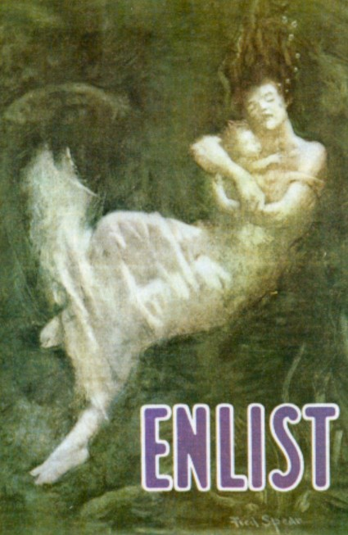
War Propaganda
Images or messages designed to get an emotional response…usually support for a war!
Result: The Lusitania turned Americans’ minds in favor of war

Slide 6
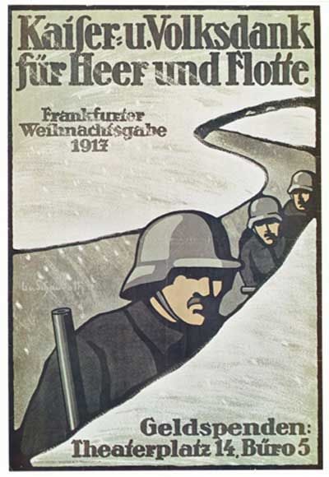
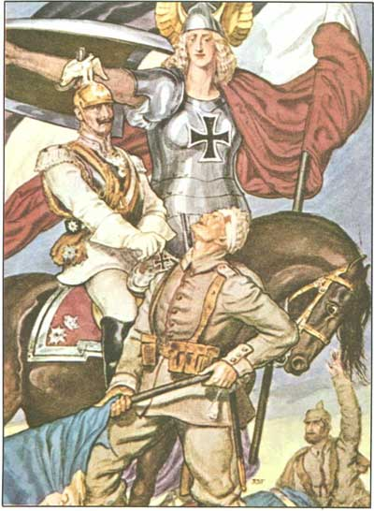
German

Slide 7
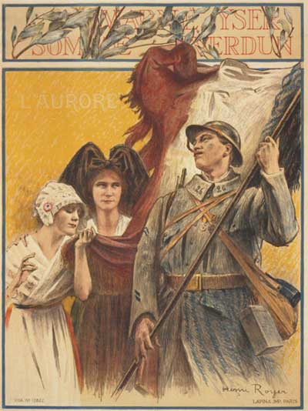
French

Slide 8
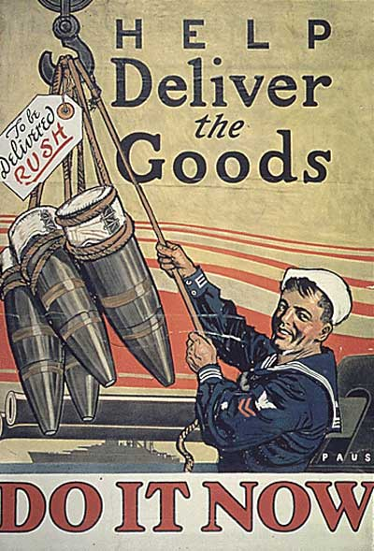
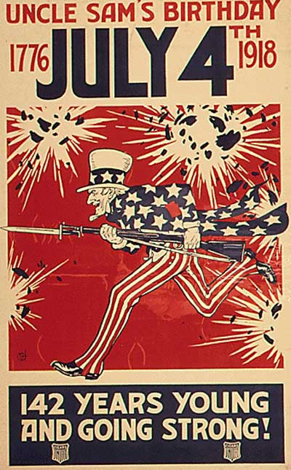
American

Slide 9
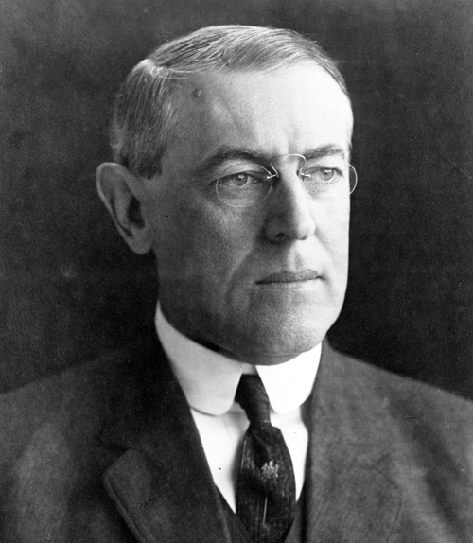
Sinking of the Lusitania
Sinking of the Lusitania turned public opinion against President Wilson who wanted to stay out of the war.
1916 re-election slogan: “He kept us out of war”
He won by one of the smallest margins in history…shows US was ready to go to war!

Slide 10
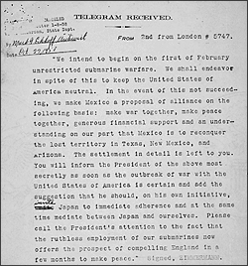
Zimmerman Note
A German telegram offering an alliance between Mexico and Germany, promising Germany’s help to recover lost Mexican territory in Texas, New Mexico and Arizona in exchange for Mexico attacking the US
The telegram was intercepted by the British and decoded
It was the “final straw” to bring the US into the war!

Slide 11
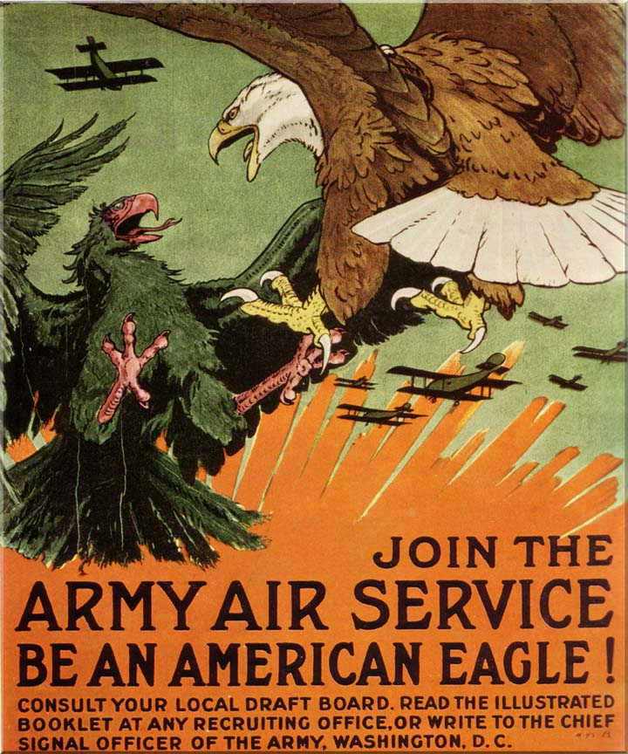
US Entrance into WWI
1917
Joins Triple Entente…becomes “The Allies”
America’s decision to enter the war was due to submarine warfare (violating freedom of the seas and America’s ties to Great Britain)
Woodrow Wilson says the US joined to “make the world safe for democracy.”

Slide 12
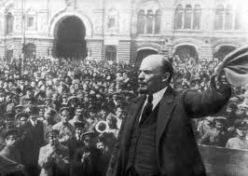
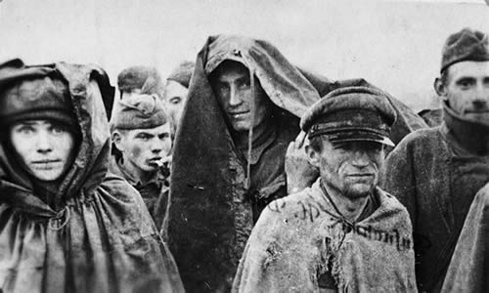
Russia Leaves the War
1917
Civil unrest in Russia…Communist Revolution!
War-related shortages
Food
Fuel
Millions of Russian soldiers killed, wounded or taken prisoner
Russian army refused to fight

Slide 13
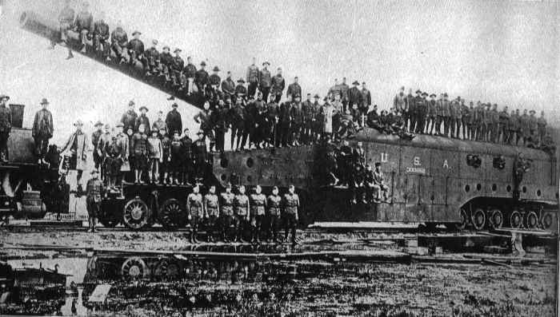
The warfare of WWI
Modern Weapons Arrive!

Slide 14
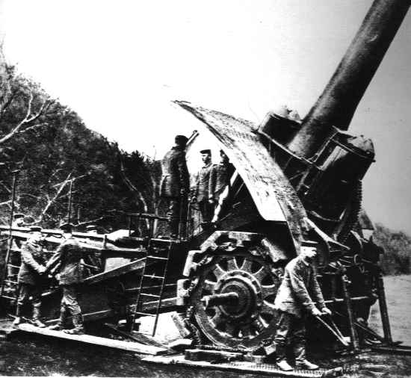
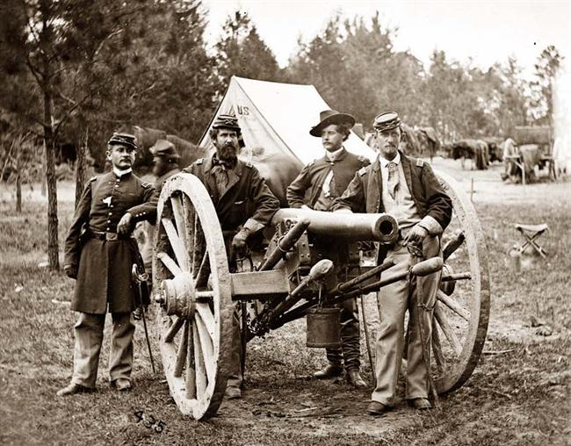
Artillery…50 years difference!

Slide 15
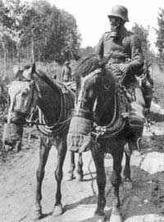
Modern Warfare
Machine Gun & Artillery: Dramatically increased fatalities on the battlefield
Poison Gas: Yellow-Green chlorine fog that sickened, suffocated, burned and blinded victims
Tanks: Used to “mow down” barbed wire and soldiers

Slide 16
Artillery canons so large could only be moved by trains

Slide 17
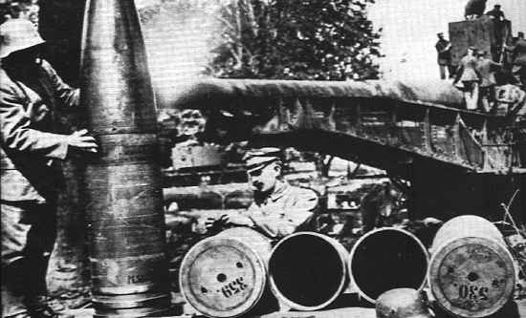
Look at the size of the artillery shell that was loaded into the artillery cannons…what would that do if it hit a man?

Slide 18
There’d be nothing left!

Slide 19
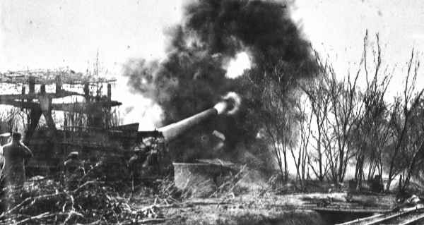

Slide 20
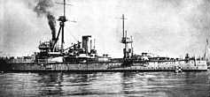
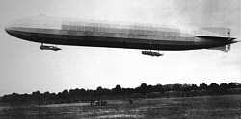
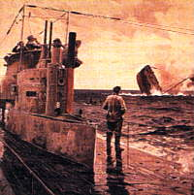
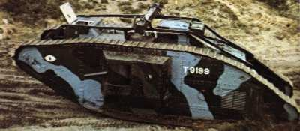

Slide 21
Trench Warfare
Trenches were dug on either side of the battlefield, opposing each other along a front because the weapons were too deadly for soldiers to stay above ground!
“No Man’s Land”: Area between trenches
Lice, rats and polluted water caused infection and dysentery
Lack of sleep, constant bombardment, battle fatigue – led to shell shock (complete emotional collapse)

Slide 22
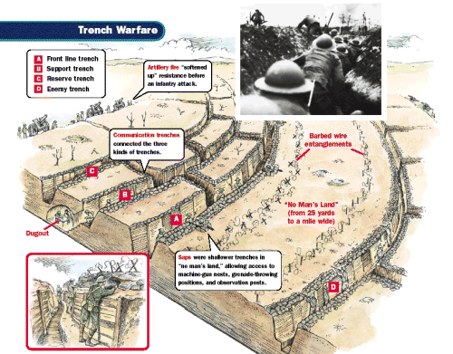

Slide 23
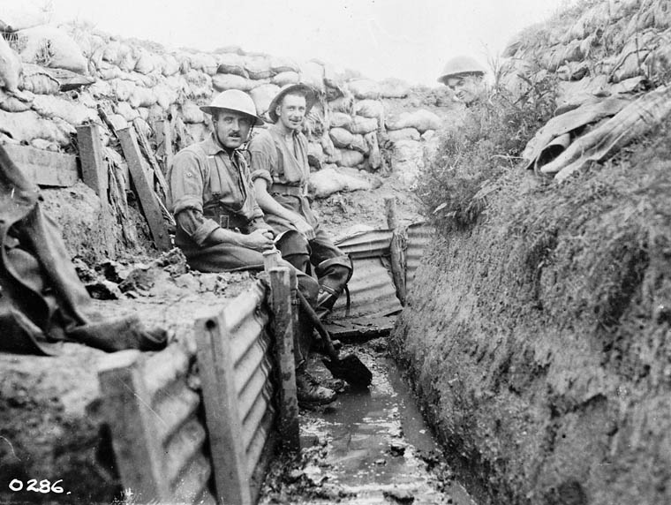

Slide 24
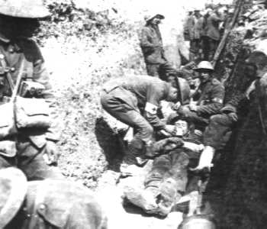

Slide 25
