Slide 1
Unit 10: Contemporary History
Today’s Current Political Issues

Slide 2
Migration- global movement of people (push-pull factors)
Push (Negative)
Pull (Positive)
Lack of food
Drought/Famine
Natural disasters
Political oppression (civil wars, dictatorships, ethnic cleansing, genocide)
Better life for self and children
Political freedom, speech

Slide 3
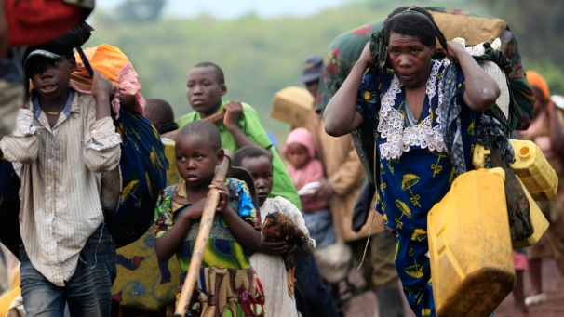
Refugees
Refugee: a person who is outside their country of origin or habitual residence because they have suffered persecution on account of race, religion, nationality, political opinion, or because they are a member of a persecuted 'social group’.

Slide 4
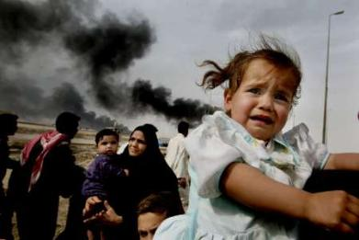
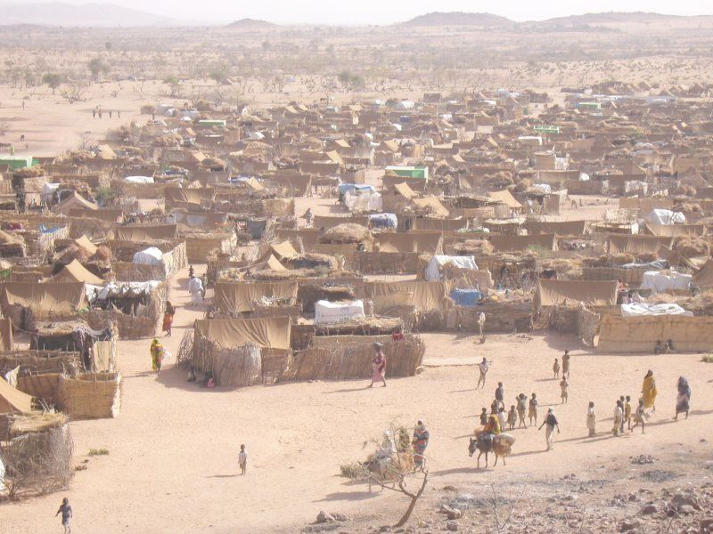
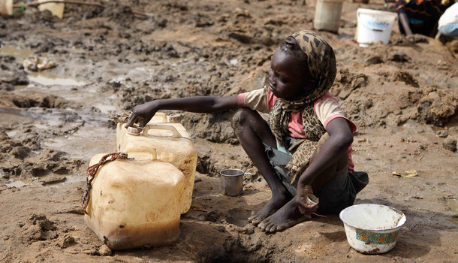
Large volumes of people migrate from war-torn, famine-stricken and politically unstable regions.
Millions of immigrants have no place to go, which leads to crowded refugee camps.
Conditions in the camps are poor: unsanitary, lack of food and medicine, clean water

Slide 5
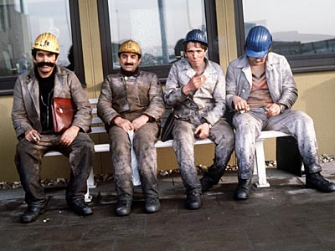
Guest Workers
A foreigner who is permitted to work in a country on a temporary basis (farm or seasonal laborer)
Understanding that they will some day return to their country of origin
Offset labor shortages
Bring experience and knowledge that can help the economy
Contribute to sharing, shaping and blending of enriched culture

Slide 6
Germany’s Guest Workers: the Turks
http://www.youtube.com/watch?v=0cSFQ0ydDlU&NR=1&feature=endscreen
Answer the questions on your notes as you watch the video.

Slide 7
Ethnic and Religious Conflicts
In more recent times, regional conflicts have occurred for different reasons
North Ireland: Protestants vs. Catholics
Middle East: Palestinians vs. Israelis
Balkans: Serbs, Bosnians and Croats
Southwest Asia: Kurds vs. Iranians
Horn of Africa: Somali Civil War, Famine

Slide 8
The Bosnian War
http://www.youtube.com/watch?v=Ae_cTGvxYGI
Answer the questions on your notes as you watch the video!

Slide 9
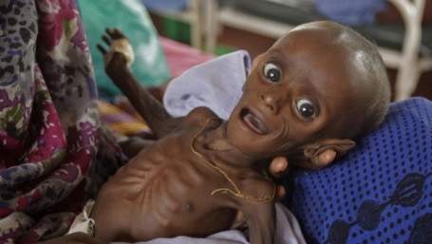
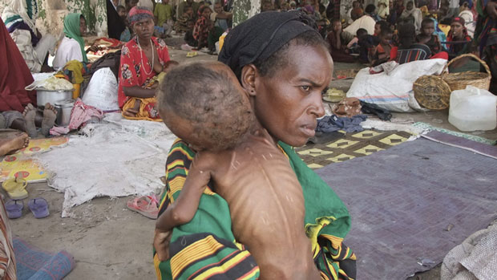
The Horn of Africa
East Africa – this region consists of the countries of Somalia, Djibouti, Ethiopia, Eritrea, and Kenya
This region has been torn apart by civil wars and widespread famine (drastic, wide-reaching food shortage) caused by droughts

Slide 10
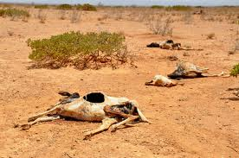
The Horn of Africa
http://www.youtube.com/watch?v=fHF-O2iSv_k
Answer the questions in your notes as you watch the UNICEF video on conditions in Somalia

Slide 11
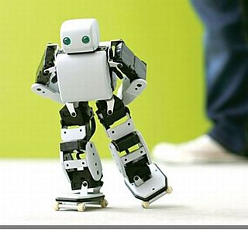
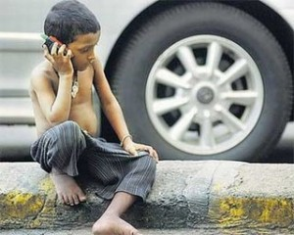
Impact of New Technologies
As technology advances, it also spreads throughout the world!
“Real time” communications with people anywhere in the world!
Negative: widespread unequal access to computers and instantaneous communications
Not all are benefitting from technologies and keeping up with the changes it brings
Nor does the new “tech” improve lives for many of the people in struggling nations

Slide 12
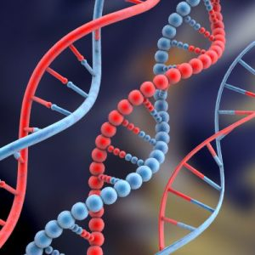
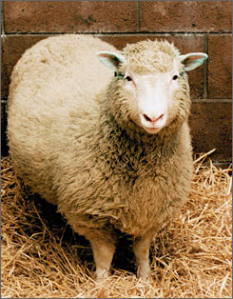
Improvements in Genetics
Genetic engineering: introducing new genes into an organism to give that organism new traits
Cloning: creating identical copies of DNA
Mapping the DNA of diseases to help with early detection or cure
Stem Cell research: to regenerate damaged organs or even grow new, healthy organs
Dolly the Sheep – the world’s first cloned mammal. Born in 1996, she only lived 6 years

Slide 13
Bioethics: Just because we can, should we?
All of these advances in medicine have raised questions and debate.
Bioethics: moral philosophy- concepts of right and wrong behavior about the study of controversial ethics brought on by advances in biology and medicine.
Should humans be cloned?
Should embryos be used to harvest stem cells?
Should we medically alter the DNA sequence of plants and animals to make them resistant to diseases?

Slide 14
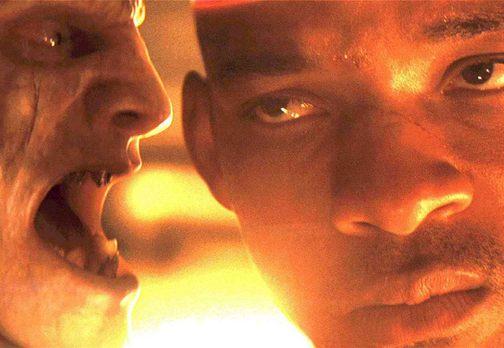
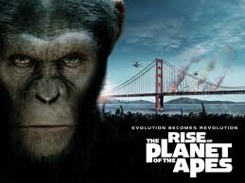
Hollywood loves bioethics!
Can you recall the bioethical question raised by each of these movies or their characters?

