Slide 1
The Philosophies of the Industrial Revolution
WHII.9b

Slide 2
Socialism
Government is best qualified to regulate the economy.

Slide 3
Capitalism
Progress results when individuals follow their own self-interest.

Slide 4
Socialism
Governments should provide for its citizens according to their needs.

Slide 5
Capitalism
Government should not interfere with the economy.

Slide 6
Socialism
Government control of crucial industries (healthcare, transportation, education) could end poverty and promote equality.

Slide 7
Capitalism
Taxes on foreign products should be eliminated to give consumers more choice.

Slide 8
Communism
People have always been divided into social and economic classes.

Slide 9
Communism
Wealthy corporations take advantage of their workers to make a profit.

Slide 10
Communism
Only a small group of wealthy people control most of the world’s wealth.

Slide 11
Communism
Economic equality for all people is possible.

Slide 12
Which of the philosophies do you tend to agree with?

Slide 13
Background…P.U.R.S.
Poor conditions in the factories and industrial towns created a large underclass of poor
Unequal distribution of wealth leads to class divisions – large gap between rich and poor
Reformers began to write new philosophies to address the needs of the poor
Standard of Living was improving for some during the Industrial Revolution but not all

Slide 14
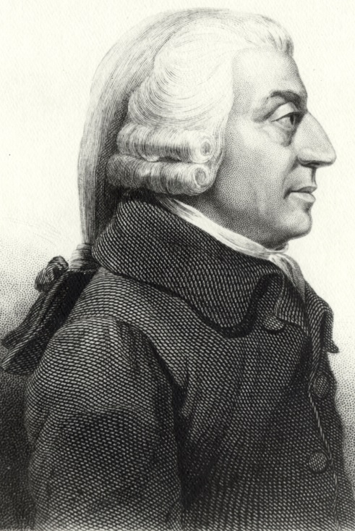
Capitalism
Key Beliefs:
Laissez-Faire: Without government regulation, the economy will prosper
Competition between businesses leads to better products (Entrepreneurs: inventors, businessmen, investors create wealth, not governments)
Free Trade: trade between countries without taxing one another’s products leads to progress
Private ownership and investment leads to profit
Adam Smith
Major Work: The Wealth of Nations

Slide 15
Socialism
Key Beliefs
Reformers advocated for social justice for the poor/working class
Government should plan the economy rather than free-markets
Government ownership of key industries would end poverty and promote equality
Producers should cooperate for the public good
Goods should be distributed according to people’s needs

Slide 16
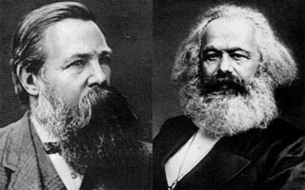
Communism
Key Beliefs:
Class Conflict has always existed between the “Haves” (bourgeoisie) and the “Have Nots” (proletariat)
Capitalism would fail and the larger underclass (workers) would revolt
Workers would control production and redistribute the wealth
economic equality would follow
No private property, classless society
Karl Marx and friedrich engels
Major work: the Communist manifesto and Das kapital

