Slide 1
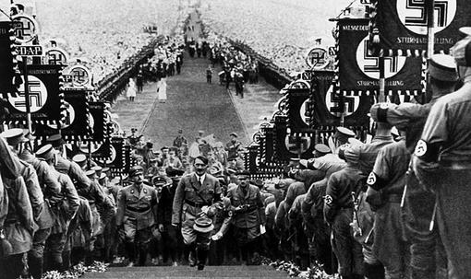
The Rise of Dictators

Slide 2
Dictators & Totalitarianism
Dictator: A ruler with unrestricted power, without any democratic restrictions
Totalitarian State: Government uses intimidation, violence, propaganda to rule all aspects of political and social life

Slide 3
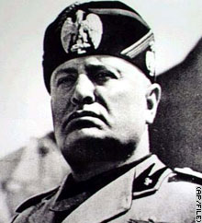
Benito Mussolini
ITALY
“Il Duce” – The Leader
Fascism emphasized…
Loyalty to the state
Obedience to the leader
Extreme nationalism and militarism

Slide 4
Mussolini wanted to..
Restore the glory of Rome
Invade Ethiopia
1 of 3 independent African countries
Despite pleas from the Ethiopian emperor, the League did nothing to stop Italy

Slide 5
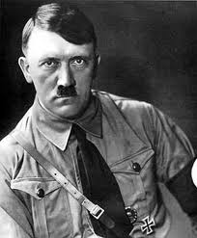
Adolf Hitler - Der Führer
GERMANY
National Socialism
Nazism → Extreme Nationalism and belief in the superiority of their race.
Nazis came to power because Inflation and Depression weakened the democratic government in Germany
Anti-Semitism: Jews blamed for the economic troubles.

Slide 6
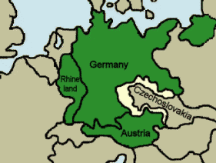
Hitler wanted to…
Occupy nearby countries (land taken from Germany in the Treaty of Versailles)
“Lebensraum” → “Living Space”
Reoccupation of the Rhineland
Annexation of Austria
Acquires the Sudetenland
Takes Czechoslovakia

Slide 7
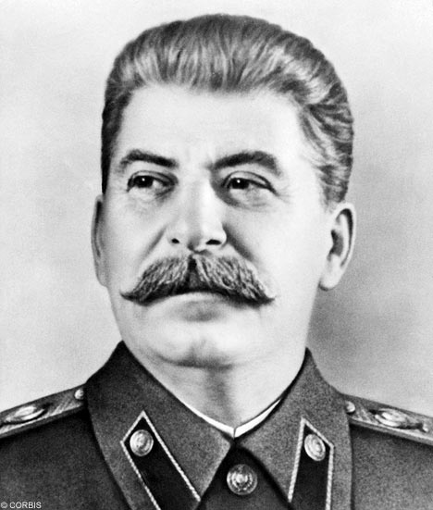
Joseph Stalin – Soviet Premier
The Soviet Union (USSR)
Soviet Communist Dictatorship…
State control of all aspects of life – the economy, politics, and society (state-run industry, secret police, totalitarianism)
After the Russian Revolution, Vladimir Lenin came to power and established a dictatorship that was continued by Joseph Stalin.

Slide 8
Stalin’s Policies
Five Year Plans → economic plans set impossibly high quotas to increase output of steel, coal, oil and electricity
Collectivization of Farms → privately owned farms are combined into large government owned farms
Secret Police → monitored telephone lines, read mail, planted informers
The Great Purge: a series of killings and deportations by the government to eliminate anyone who threatened Stalin’s power
Historians estimate nearly 700,000 people were executed between 1937-1938 alone!

Slide 9
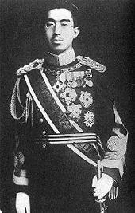
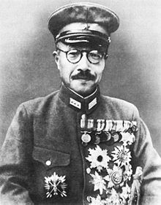
Hideki Tojo & Emperor Hirohito
Japan
Japanese Militarism emphasized:
Power given to the military to Increase the country’s military strength combined with aggressive plans for Imperialism in Asia! Hirohito is just a symbol for his country. The military, under Tojo have all the power!
Japan will invade: Korea, Manchuria, and China – all before the start of WWII
Tojo

Slide 10
Hideki Tojo wanted…
Raw Materials: As Japan continues to industrialize, they need oil, metals, and other supplies – so they take over other lands for it!
The League of Nations fails: When they protest the invasions, Japan leaves the League in 1933

