Slide 1
The Middle East Setting the Stage for Conflict

Slide 2
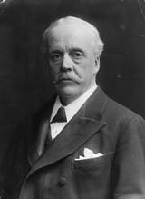
The Ottoman Empire Ends, Mandate Begins!
After World War I, the Ottoman Empire was defeated and their control of the region ended – the British take over Palestine as a mandate
By 1917, more Jews had moved into the region demanding a Jewish homeland, Arabs in the region object
Once the British take over, they promise both Arabs and Jews their own homelands (Balfour Declaration)
Constant fighting between Jews and Palestinian Arabs continues to grow and the British fail to create a homeland for either!
Sir Arthur Balfour, Britain Foreign Secretary and author of the “promise” that never came true!

Slide 3
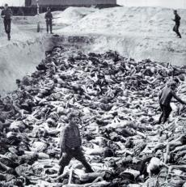
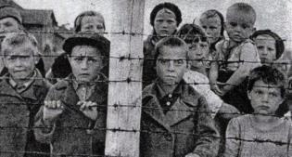
World War II – Israel is formed!
By the end of World War II, the UN stepped in!
In 1947, the UN agreed to partition (separate) Palestine into an Arab Palestinian state and a Jewish State
Jerusalem would be an international city since Jews, Muslims, and Christians all claimed Holy sites there
After the Holocaust, worldwide sympathy for Jewish survivors led to the creation of Israel (34% of the population, the Jews, got 55% of the land)

Slide 4
What about the Palestinians?
Arab Palestinians and all surrounding Islamic countries voted against partition – UN had no right to break up a country without considering the rights of the majority that lived there!
May, 1948: the independent Jewish country of Israel is formed…Palestinians got nothing, no homeland!
The day after Israel declared itself a state, six of its neighbors invaded (Syria, Lebanon, Iraq, Jordan, Saudi Arabia, and Egypt) – the first of many Arab-Israeli Wars!

Slide 5
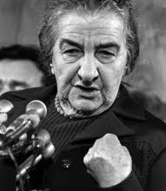
Golda Meir
First woman prime minister of Israel
Sought support of the United States
After setbacks, led Israel to victory in Yom Kippur War (1973)
Attack by Egypt on Yom Kippur, most holy day in Jewish faith
Won war and regained most of Israel’s lost territory

Slide 6
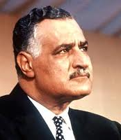
Gamal Abdel Nasser
President of Egypt during the Cold War
Established strong relationship with the Soviet Union as opposition to Israel and the United States
Nationalized Suez Canal
Takes back control from the British and even threatens access for other countries
Built Aswan High Dam
To control the Nile River and provide electricity for the country

