Slide 1
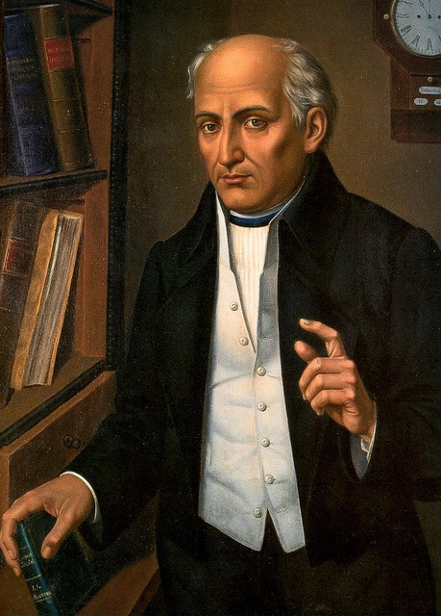
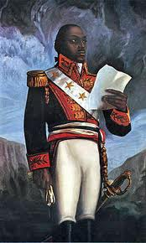
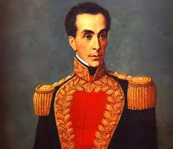
Latin American Revolutions

Slide 2
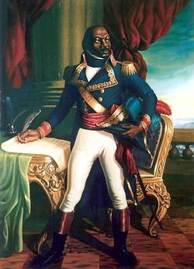
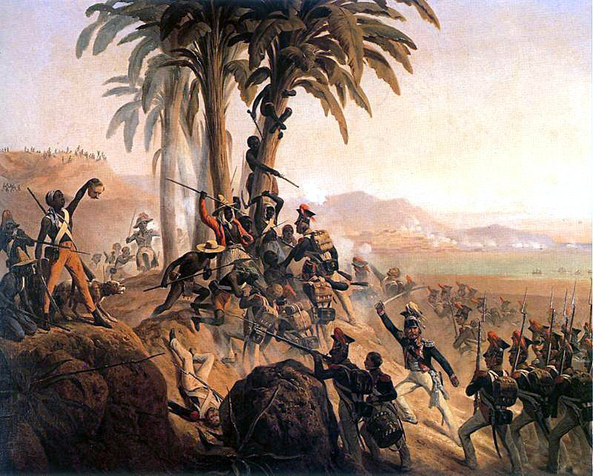
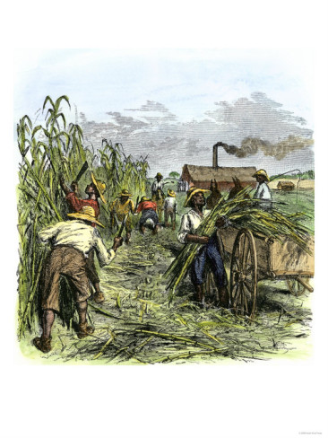
Haiti
African slaves were main workforce on sugar plantations
During French Revolution, 100,000 enslaved Africans revolted against their masters
Toussaint L’Ouverture, a former slave, became the military leader
By 1801 he took control of the island & freed all the slaves

Slide 3
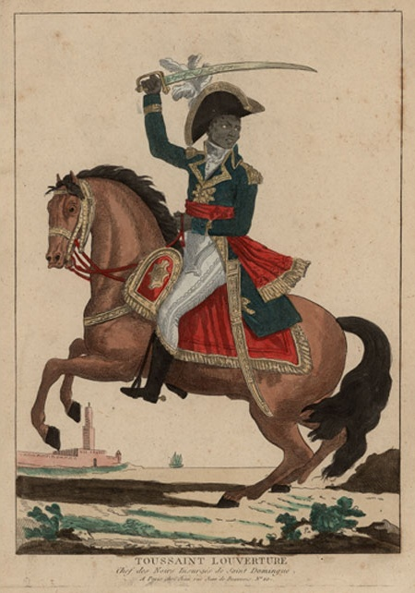
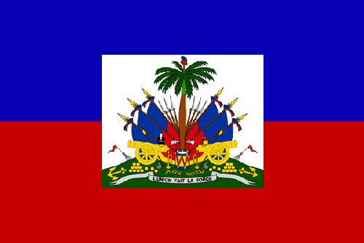
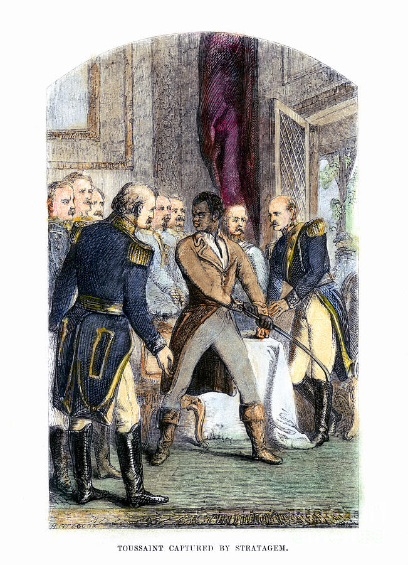
Haiti Cont’d
He agreed to end the uprising if the French promised to end slavery
The French agreed, but later tricked him & imprisoned him in the Alps for the rest of his life
Haiti declared independence on January 1, 1804
The first black colony to free itself from European control

Slide 4
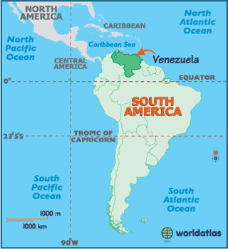
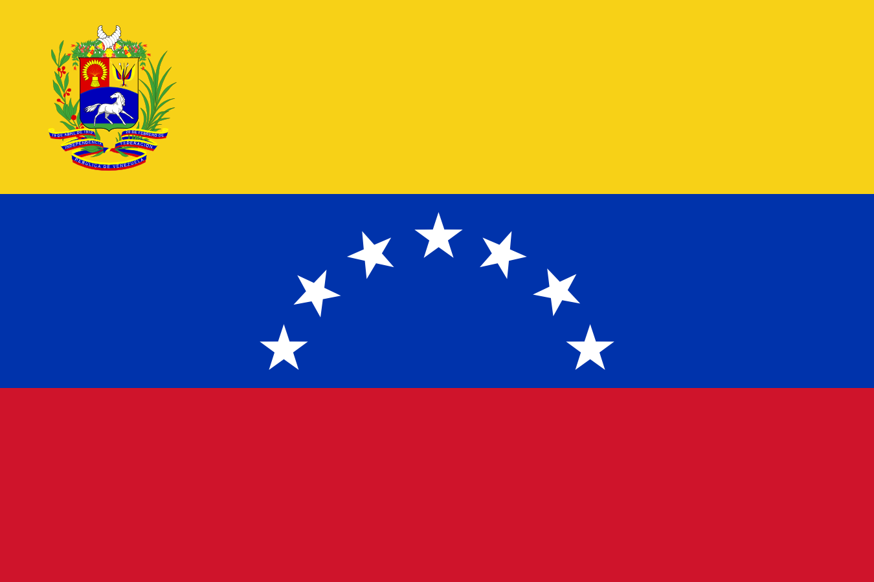
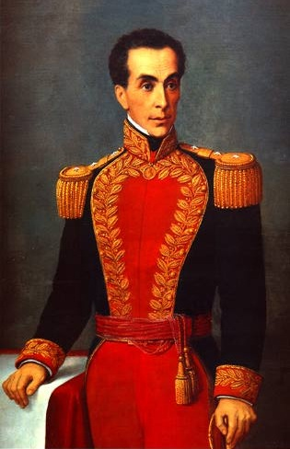
Venezuela
Independence was initially declared in 1811
Military was led by a wealthy Venezuelan Creole, Simon Bolivar
Bolivar led the army for 10 years
Was exiled twice before finally gaining independence for Venezuela

Slide 5
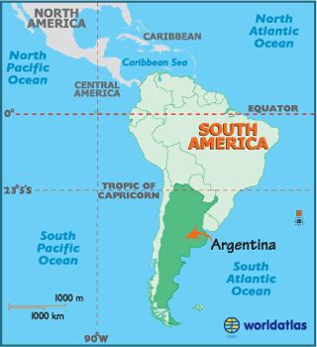
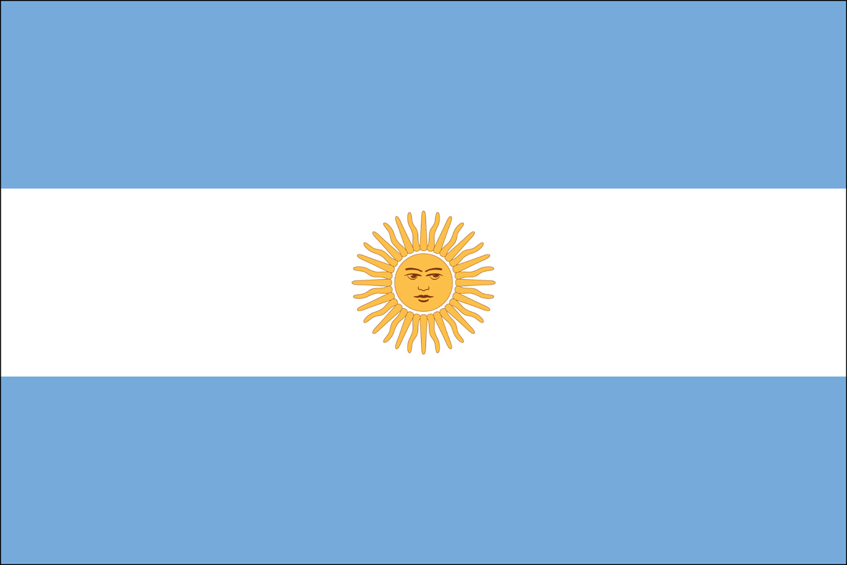
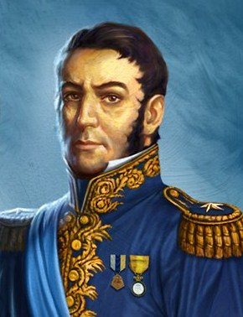
Argentina
Argentina declared independence in 1816
Spanish forces in Chile & Peru continued to pose a threat to Argentina’s independence
Jose de San Martin, joined forces with Simon Bolivar to secure independence for Argentina

Slide 6
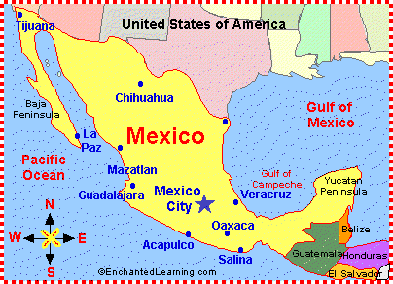
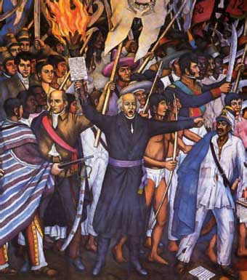
Mexico
Indians & mestizos mixed more freely & played a leading role in revolutions
1810 Padre Miguel Hidalgo, a priest from the village of Dolores, issued a “call for rebellion” (“Grito de Dolores”)
He organized 80,000 men to revolt against the Creoles & the Spanish
The Creoles & Spanish feared the loss of their land, fought back & defeated Hidalgo in 1811

Slide 7
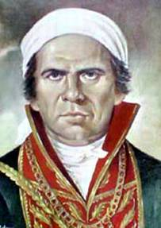
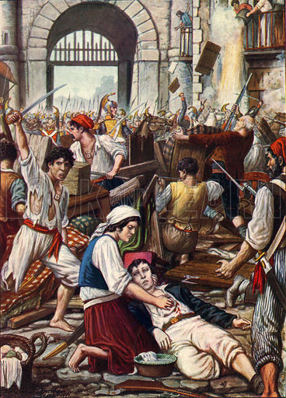
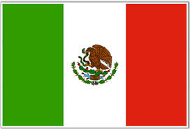
Mexico Cont’d
The rebels then chose leader Padre Jose Maria Morelos. He was defeated in 1815
Mexico gained independence in 1821

Slide 8
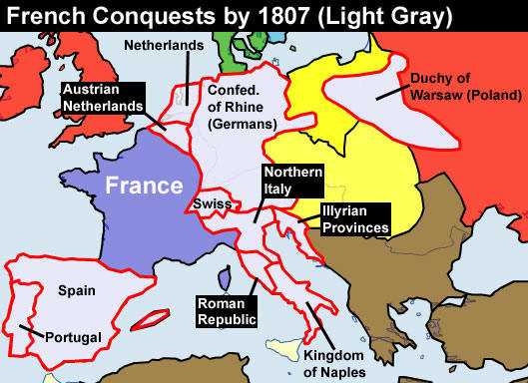
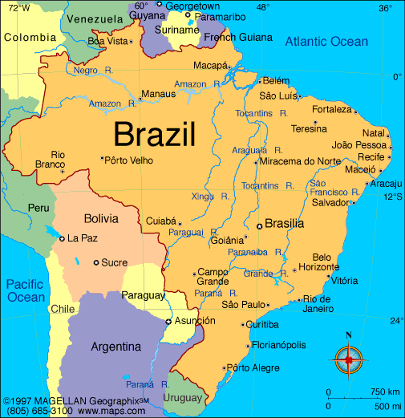
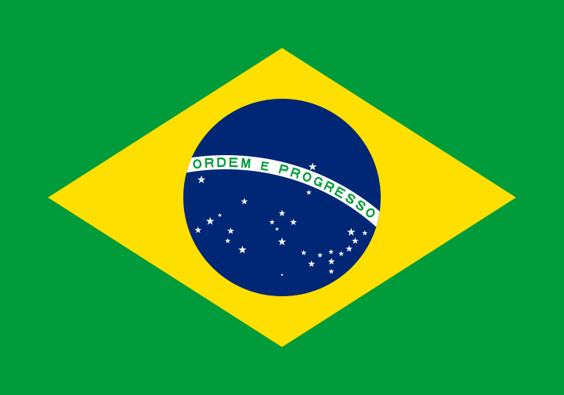
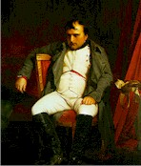
Brazil
In 1807, Portugal was invaded by Napoleon
Portugal’s royal family moved to Brazil & continued to rule
In 1815 Napoleon was defeated, the royal family returned to Portugal, but left behind Prince Dom Pedro
The people of Brazil asked Dom Pedro for independence & he agreed
Brazil gained independence in 1822 without any bloodshed

Slide 9
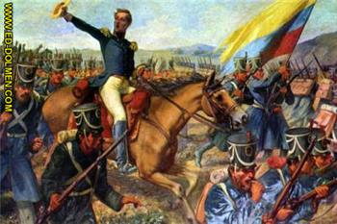
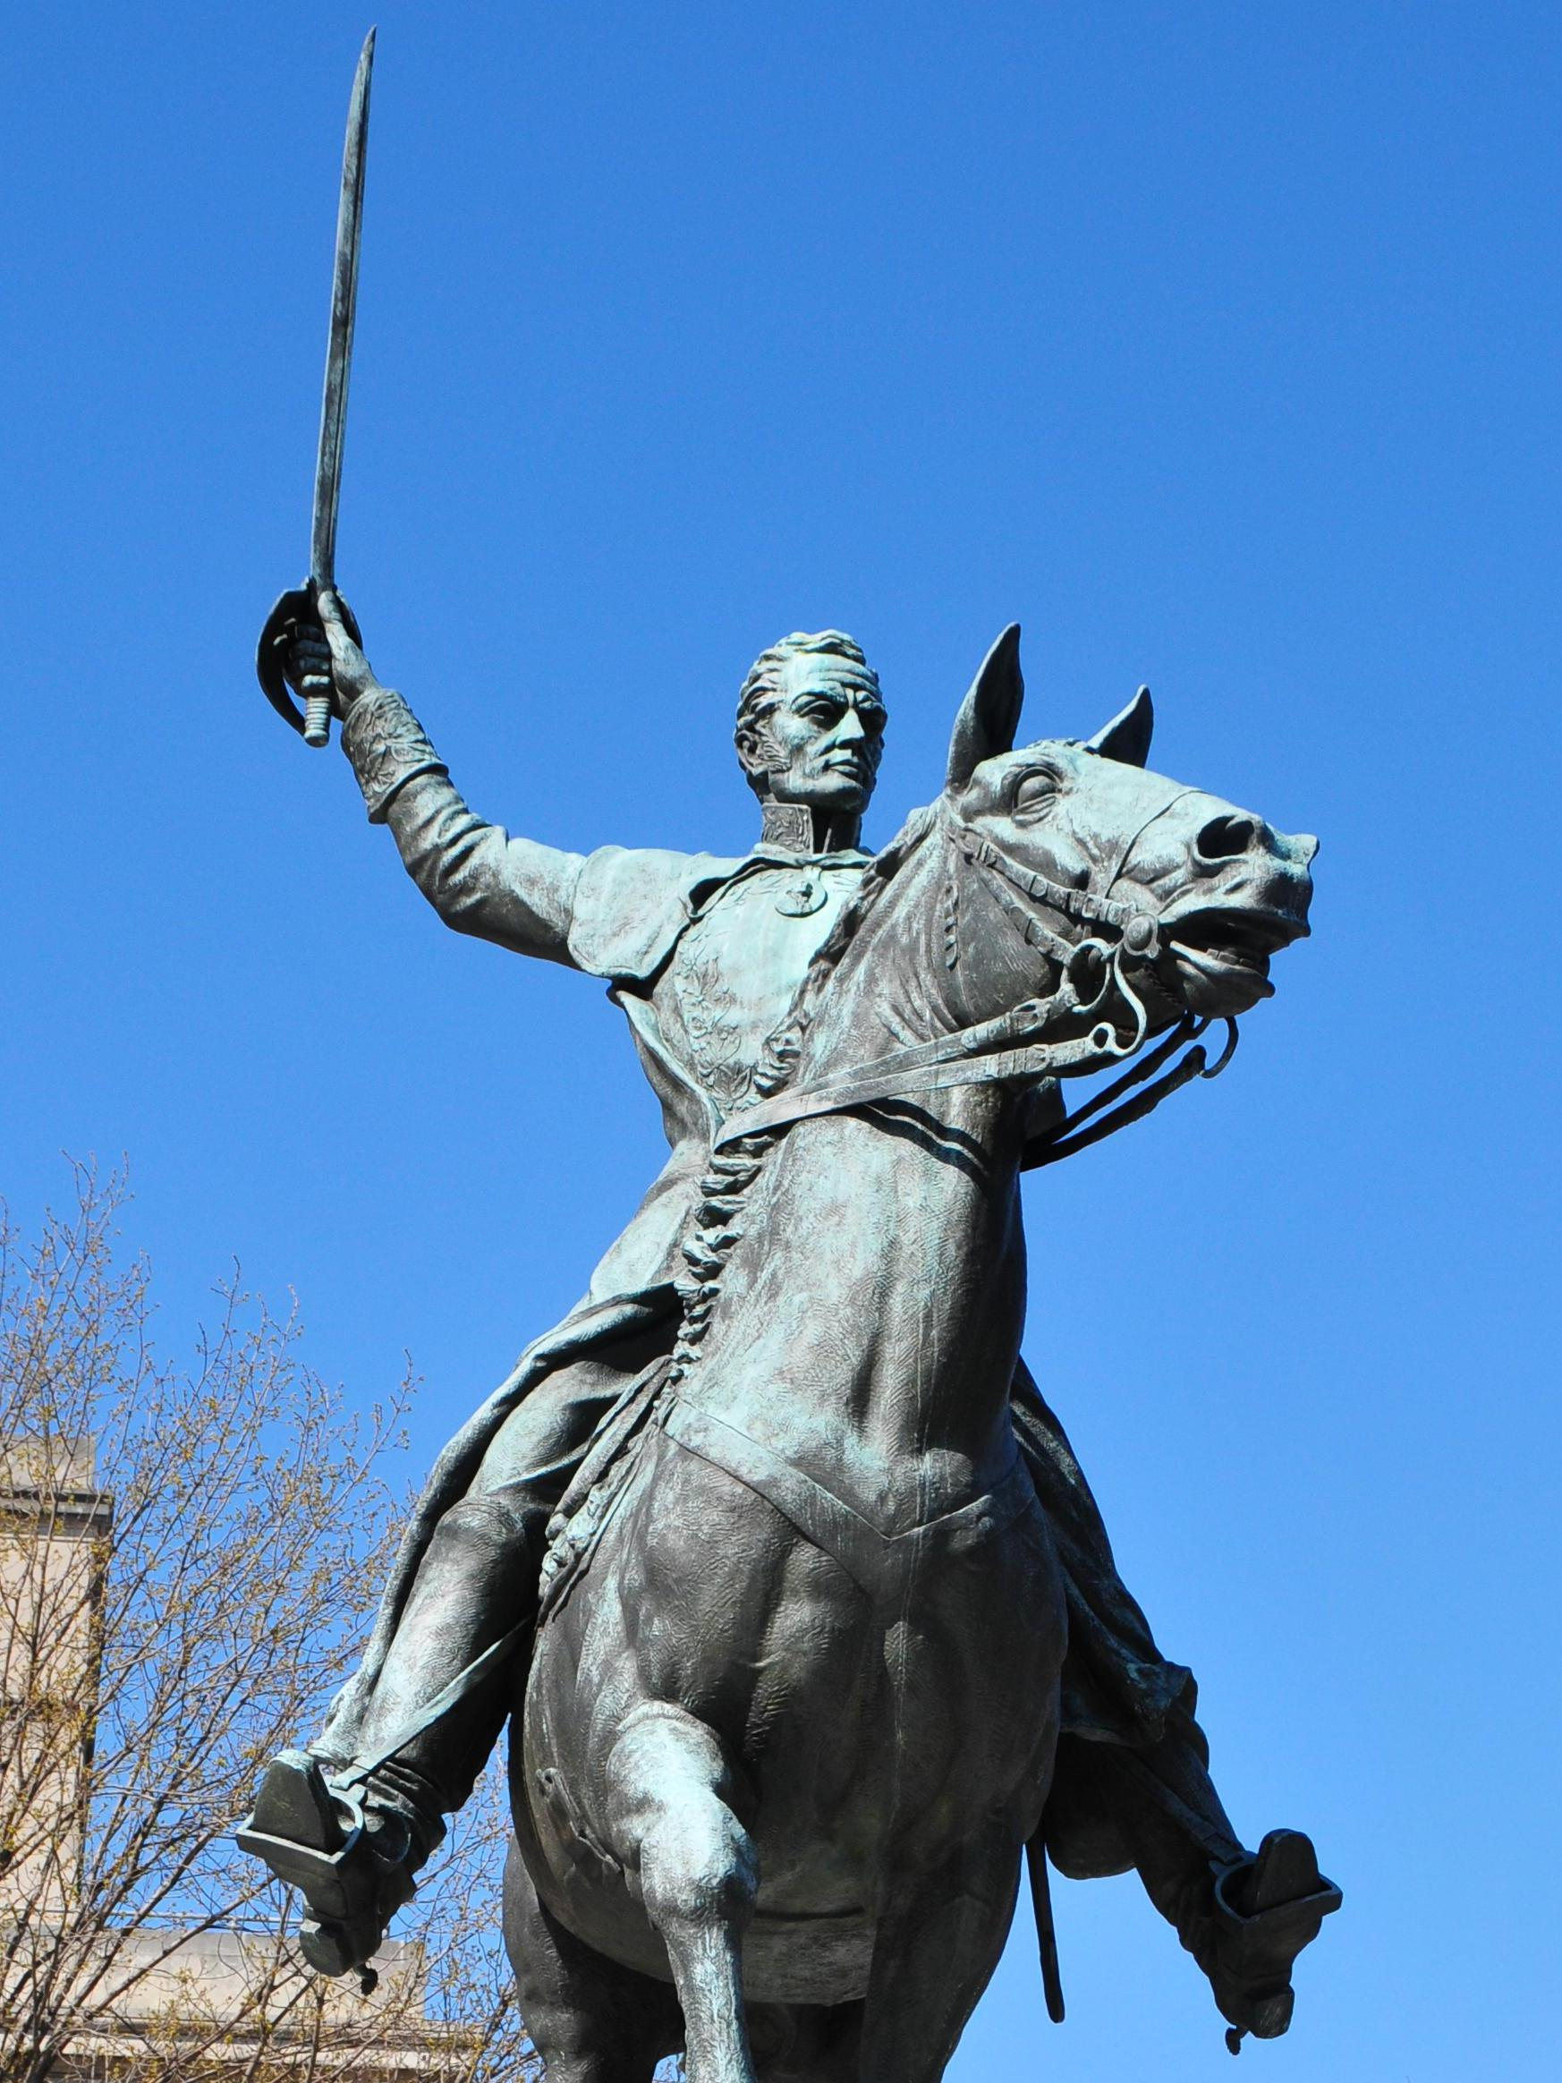
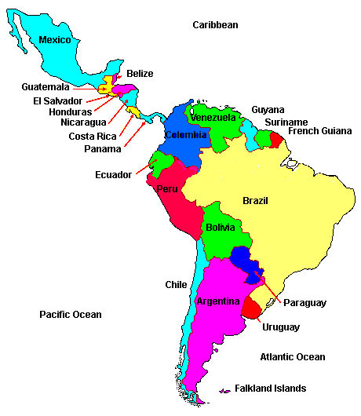
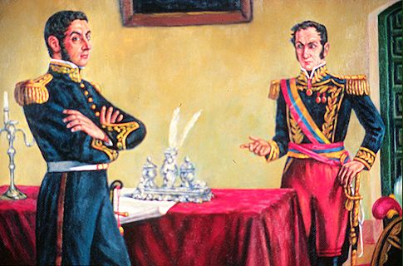
Other Colonies
Bolivar marched south into Columbia where he met up with Jose San Martin
Together, they freed Chile, Peru, Panama, & Ecuador.
All Spanish colonies became independent after the Battle of Ayacucho (Peru) in 1824
Bolivar is credited with liberating the northern areas of Latin America

