Slide 1
Major States & Empires in 1500
WHII.2a and 5a, b, c

Slide 2
Ottoman Empire
Original Location:
Asia Minor
Rise to Power: Conquest of Constantinople (1453)
Renamed Capital: Istanbul
Suleiman expanded empire to:
Southwest Asia
Southeastern Europe, Balkan Peninsula
North Africa

Slide 3
Unifying Force: Islam united the empire.
Also accepted minorities to continue to follow their own religion (religious tolerance)
Trade Route used: Silk Road
Trade Goods: ceramics and coffee.

Slide 4
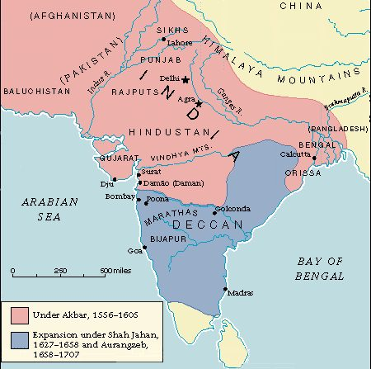
Mughal India
Location: Northern India
Descended from: the Mongols
Contributions:
Spread Islam to India but clashed with Hinduism
Art & Architecture – The Taj Mahal
Trade Routes used – coastal outposts & maritime routes
Traded – Indian textiles (cloth) that influenced the British textile industry

Slide 5
Competition!
While the Mughals traded with Europeans, England and the Netherlands competed for the Indian Ocean trade
Southern India remained mostly independent from the Mughals and traded Silks, Spices, and Gems!
No wonder the Age of Exploration began…India had the good stuff!

Slide 6
The Taj Mahal was built by Mughal emperor Shah Jahan in memory of his third wife, Mumtaz Mahal. Construction began in 1632 and ended in 1648. It is built out of pure white marble! Did you know it changes color?

Slide 7
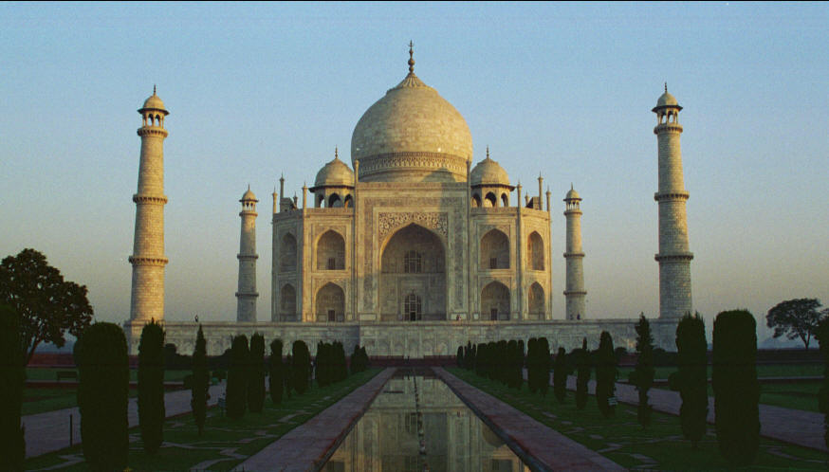
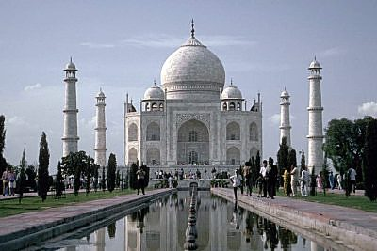
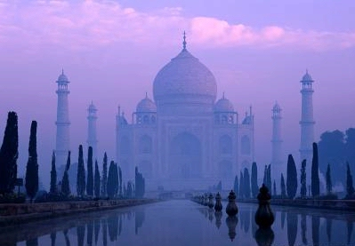
SUNRISE
DAY
DUSK

Slide 8
Persia
Location: modern day Iran
Trade Routes used: Silk Road and maritime routes
Traded: medicine, astronomy, math

Slide 9
Songhai
Location: West Africa
Trade Route used: Trans-Saharan
Trade Goods: slavery, ivory, gold
Sadly, this region is where Europeans will begin the slave trade and continue it for centuries!

Slide 10
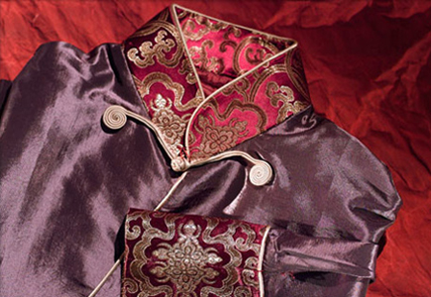
China
Location: East Asia
Governed by: Imperial policies
Created: Foreign Enclaves (specific locations for trade)
GOAL: to limit foreign influence!
Trade Route: Silk Road
Trade Goods: paper, compass, silk, porcelain, tea
Result: increased European demand for Chinese goods!

Slide 11
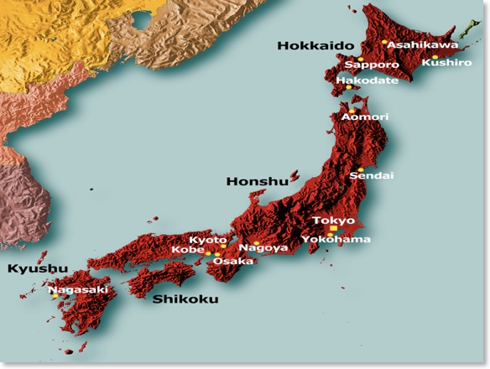
Japan
Location: East Asia
Controlled by: Shogun
Powerless Emperor
Policy of isolationism (no trade with anyone)
GOAL: to limit foreign influences.

Slide 12
European Nations
Countries:
England
France
Spain
Russia
Competition (especially England and the Netherlands) over Indian Ocean Trade led to establishing coastal ports along the Indian subcontinent

