Slide 1
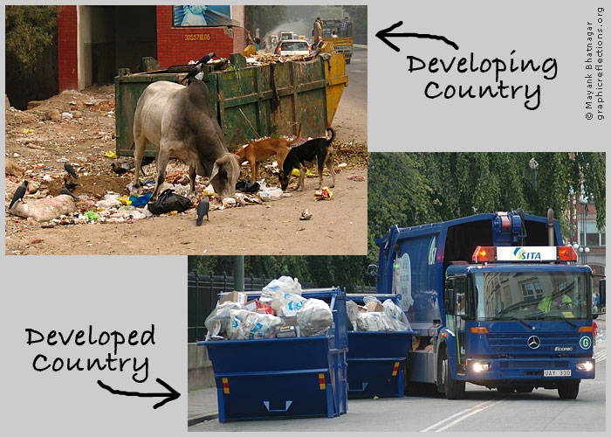
The Developed versus The Developing World

Slide 2
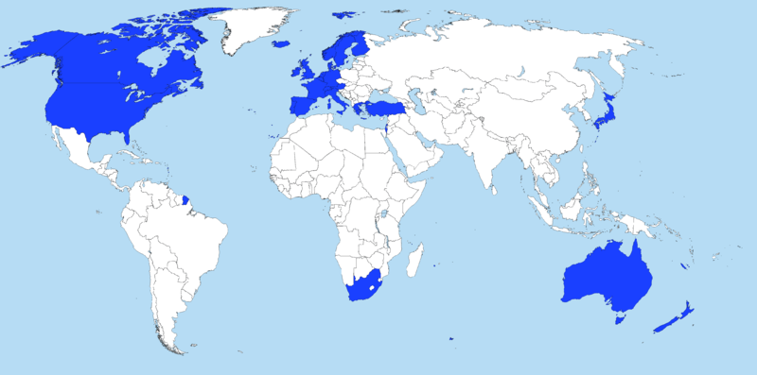
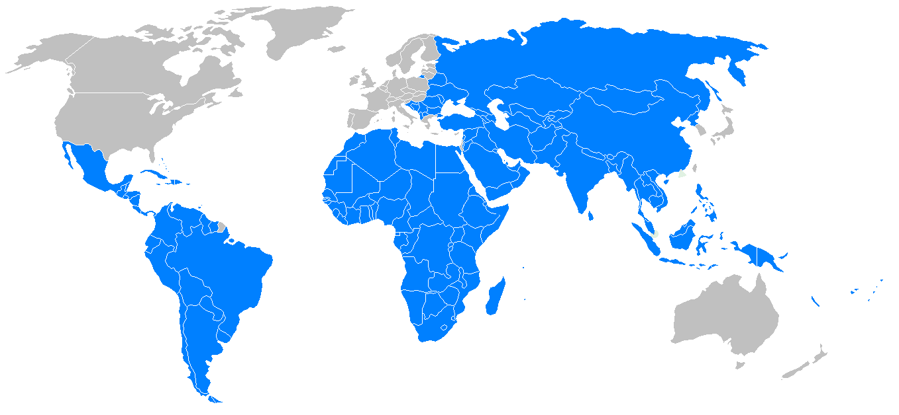
What do you notice?
Developed
Developing

Slide 3
Developed Nations
Nations with the industries, transportation, and business facilities capable of advanced production of manufactured goods.
These nations can provide for the needs of its citizens and have the economic and political stability to provide opportunities for invention, job growth, and technological advances

Slide 4
Developed Characteristics
Include:
Regular economic growth and security
Advanced industries: tech, software, telecommunications
widespread infrastructure: roads, schools, hospitals/health care, transportation (meet the needs of the citizens)
High rates of literacy (ability to read and write)
Per capita income: average income that a single citizen makes
(US = $49,800 per year)
High standard of living

Slide 5
Developing/Emerging Nations
Nations that are in the process of becoming industrialized.
They usually receive international aid from developed countries to help with their development
These nations still struggle to provide necessary services for their people or keep their economy growing

Slide 6
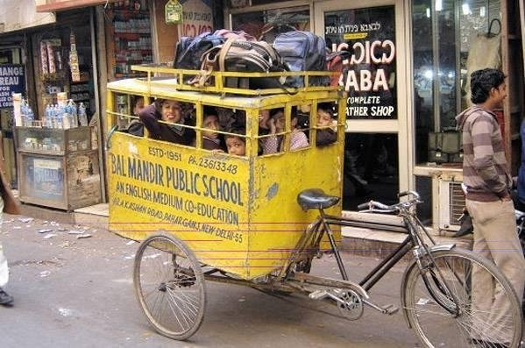
Developing Characteristics
Include:
low income (Somalia’s per capita income = $6oo per year!)
inadequate housing
Lack of health care services = disease, high birth rates/low life expectancy (US life expectancy is 78 yrs old…South Africa’s is only 49!)
Inadequate/non-existent public services
No schools = illiteracy, no work skills, no way to improve, no experience means no business owners/managers to raise capital (money) to create new jobs
High population rates

Slide 7
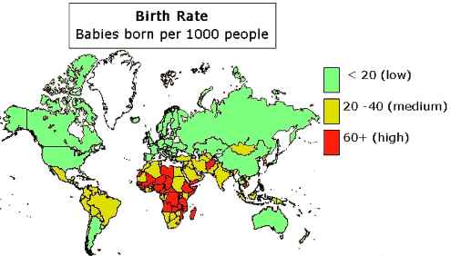
High Birth Rate = Developing
Parents in developing countries, tend to have lots of children because they know that some will not survive, also they are expected to help their families and support their parents when they get older

Slide 8
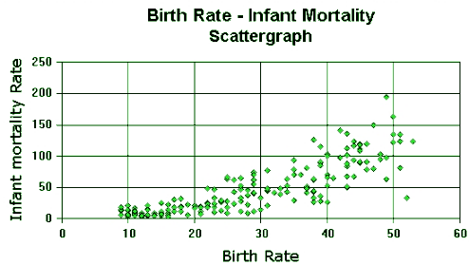
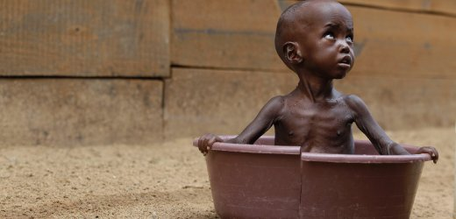
High Infant Mortality Rates
This graph shows the sad reality that countries where children are dying very young tend to have higher birth rates as these families produce more children to replace the ones they lost!

