Slide 1
Global Impacts and Global Organizations

Slide 2
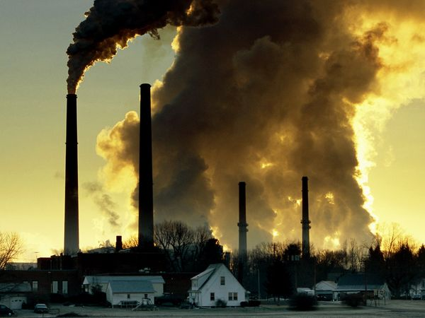
Environmental Challenges
Technology and industrialization have helped to raise the standard of living for many people, however, there has been a negative impact on the global environment.
Most significant result of industrialization is an increase demand for energy and resources…oil, coal, natural gas, nuclear power
What impact can these resources have on the environment?

Slide 3
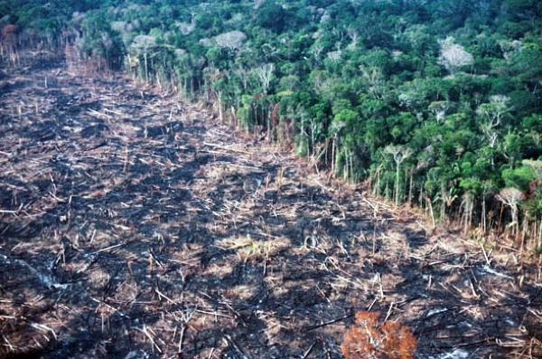
Pollution
Increased manufacturing and increased populations have also led to an increase in pollution (waste created by industries and population centers)
This can lead to shortages of natural resources…even clean water!
Loss of natural habitats (environments home to native species and plant life) in order to obtain more resources

Slide 4
Global Climate Change
Greenhouse Effect
http://www.youtube.com/watch?feature=player_embedded&v=ScX29WBJI3w
Answer the questions on your notes as you watch this video clip from the EPA (Environmental Protection Agency)

Slide 5
Social Challenges
Overpopulation
Overpopulation occurs when there are too many people for the natural resources of an area to support which leads to:
Poverty
Poor health
Illiteracy
Famine
Migration
Economic & Political Connection: a free market economy leads to high standard of living, a growing middle class, and increased political rights and individual liberty (Taiwan and South Korea are more recent examples of successful economic and political growth!)

Slide 6
Economic Interdependence
Globalization
Today, globalization means worldwide exchange of culture, business, ideas…this has created a global economy…it has also made countries dependent on one another for the health of their economies! (Warning: what happened in 1929?)
Businesses have set up inside foreign countries and been a great benefit to developing countries : job growth, increased industrialization
Multinational corporations: Companies that operate in a number of different countries. Have plants, offices, or stores in other countries
Exxon, Ford, Toyota, BP, Aéropostale, Wal-Mart

Slide 7
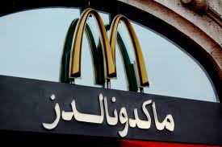
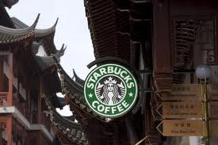
International Communication
The development of modern technology has created rapid transportation, communication, and computer networks
Today’s world is far more connected than at any other time in world history!

Slide 8
Global Organizations
Trade Agreements
In order to spur trade, countries got together to create trade agreements. Designed to eliminate or greatly reduce tariffs (taxes on imported goods)among member countries.
The more interaction between countries changes the role of international boundaries and relationships.
The more globalization that has developed, the greater the role for international organizations to bring countries together!

Slide 9
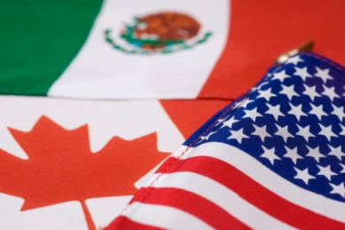
NAFTA
NAFTA- North America Free Trade Agreement- this trade agreement between Canada, US, and Mexico reduces trade restrictions between the three countries in order to encourage more business and increase the wealth for all three!

Slide 10
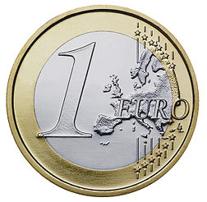
Regional Integration
EU
Should Europe function more like our 50 states do? Should they have a common currency and allow people to travel freely throughout the continent? THEY DO!
The EU- European Union- 27 mainly European Nations that share a common currency (the Euro) and encourage trade and travel between nations
This regional integration encourages globalization but others worry it takes away from the individual sovereignty and culture of the participant countries

Slide 11
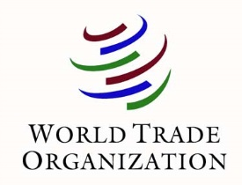
The World Trade Organization
The WTO
Supervises and encourages international trade
Provides regulations for trade and a means to settle any disputes between nations that arise
Allows for negotiations and formalization of agreements between nations
Critical Thinking Question: What does the WTO and the UN have in common?

Slide 12
The International Monetary Fund
The IMF
The IMF focuses on increasing economic growth for countries around the world by:
provides assistance to developing countries
secures international financial stability
promote international trade, employment, and economic growth
Help to reduce poverty around the world

