Slide 1
Absolutism & Glorious Revolution (6b & c)

Slide 2
Absolute Monarchs
Who were the absolute monarchs?
What effect did the absolute monarchs have on their countries?
How did the English Civil War & the Glorious Revolution promote the development of the rights of Englishmen?

Slide 3
These factors helped to strengthen the
monarchs between 1500-1800:
• Cities concentrated people and money
together, where the monarch could control
them more easily
• Rulers to establish law and order across their
kingdoms.
• Monarchs could reap the benefits of those
colonies. THINK MERCANTILISM
• KINGS could NOT make their rule absolute
without overcoming the resistance of the
nobility, the Church, and the rival monarchs
of neighboring kingdoms.

Slide 4
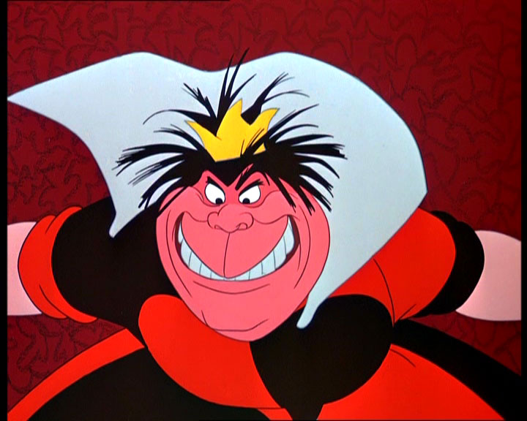
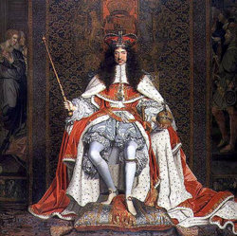
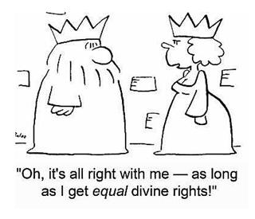
Characteristics of absolute monarchs
Centralization of power
Rule without limits
Concept of rule by divine right
God created the monarchy & the monarch was God’s representative on earth

Slide 5
How to be an absolute ruler!
The Palace of Versailles: Large, Impressive, symbol of the power of the king!
http://www.youtube.com/watch?v=XxIzMr2Ekpo
Cost: estimated $3 billion dollars today 36,000 laborers & 6000 horses worked on the palace Main Building 500 yards long & two wing buildings 150 yards long 2000+ rooms, 15,000 acres, & 1,400 fountains
Model yourself after the Sun God and you too can be at the center of the universe…and your country! As necessary to your people as the sun – order, power, heat

Slide 6
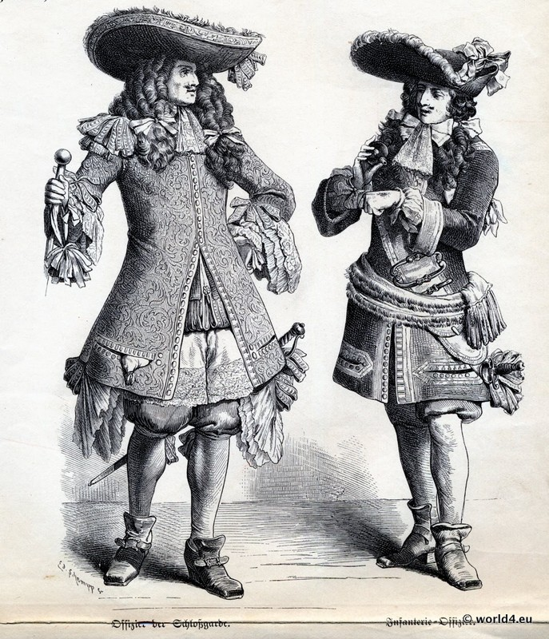
How to be an absolute ruler!
Clothing…competition for the king! Dressing and Undressing the king was a privilege granted to only certain Nobles
Dress codes required for the nobles at court, the king tells you what to wear!
Only those properly dressed could visit the gardens of Versailles!

Slide 7
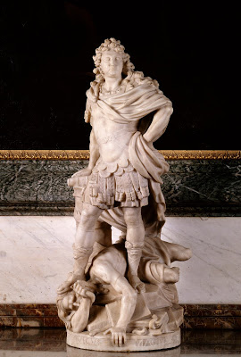
How to be an absolute ruler!
Have absolute control!
Louis XIV ended the Edict of Nantes! No more religious tolerance allowed for France. The Protestants must be destroyed!

Slide 8
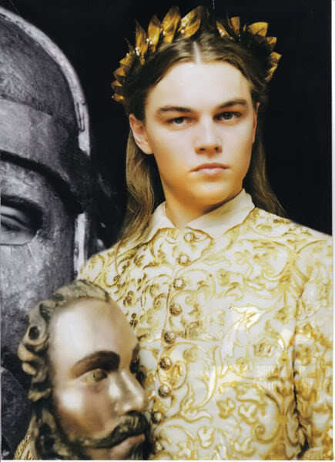
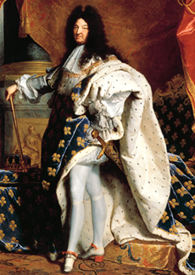
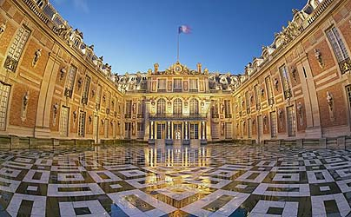
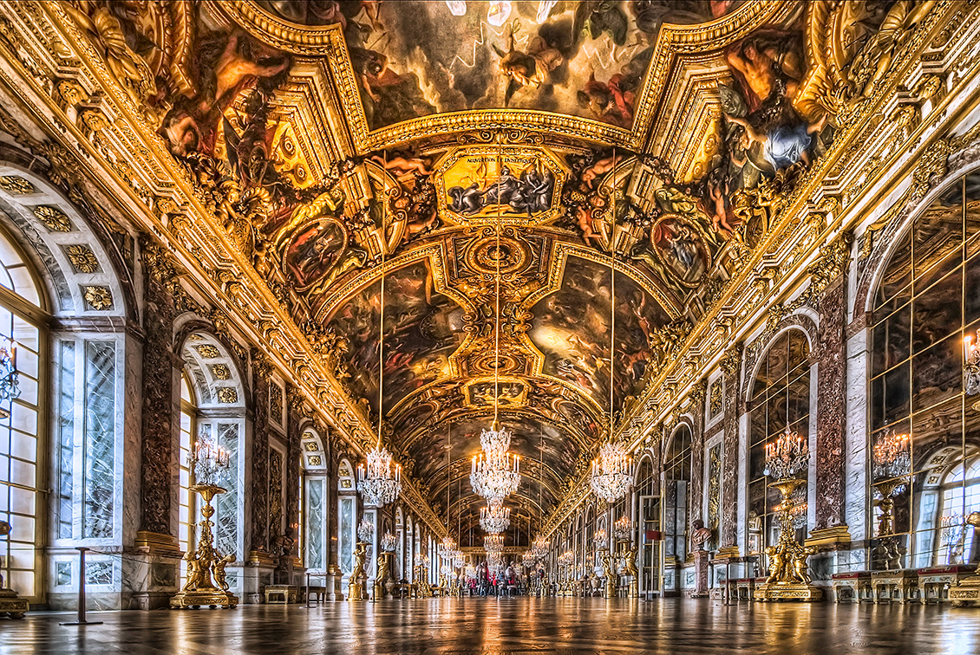
Louis XIV of France
Palace of Versailles as a symbol of Royal Power
Became king at 5!
Controlled nobles in order to keep power to himself
Moved seat of government to his palace – CENTRALIZED authority! Under his watchful eye and control!
“L’etat c’est moi!”-
“I am the state!”

Slide 9
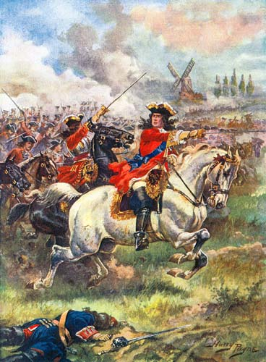
War of Spanish Succession
King Charles II died & promised throne to Phillip of Anjou, Louis XIV’s grandson
Other countries felt threatened by great power
Louis’ grandson allowed to remain in power, but thrones of France & Spain could not be united

Slide 10
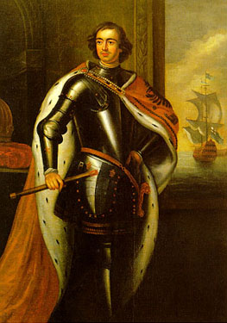
Peter the Great Tzar of Russia (1682-1725)
Became Tzar at the age of 10.
Put Russia through a series of reforms to westernize the country and make it an equal in European power
He was 6’ 8” tall!!!

Slide 11
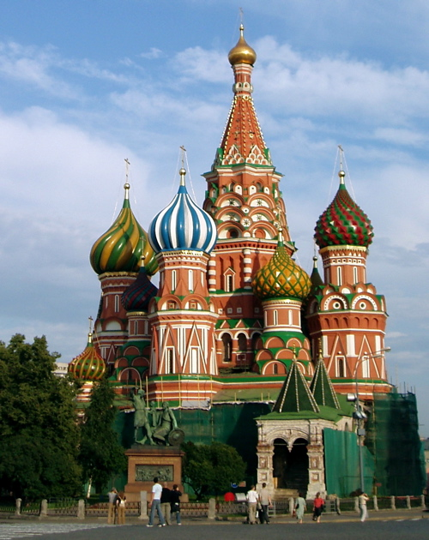
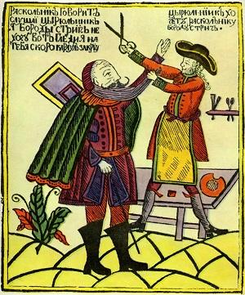
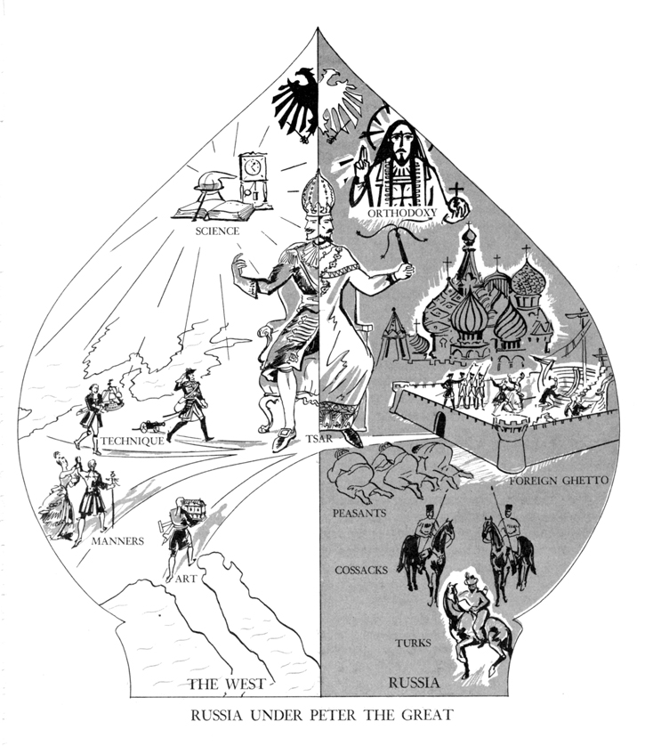
Peter the Great of Russia
Increased the czar’s power
Brought Russian Orthodox Church under state control & ran it (Centralization of Power)
Reduced power of landowners
Westernization of Russia
Introduced potatoes
Started first newspaper
Raised women’s status
Ordered nobles to adopt Western fashions
Advanced education by opening schools of navigation, arts, & sciences

Slide 12
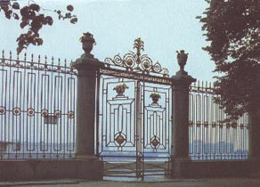
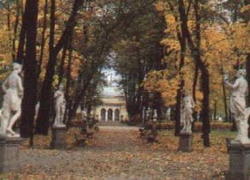
Peter’s Summer Palace

Slide 13
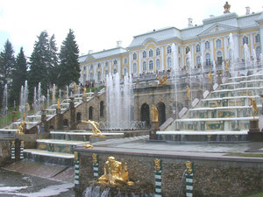
The Grand Cascade

Slide 14
Prussia 1740-1786 frederick the great
• Becomes monarch of Prussia
• Centralizes power in himself
• Builds strong military to strengthen Prussia
He reformed the military and government, established religious tolerance and granted a basic form of freedom of the press.
He strengthened the legal system and established the first German code of law.
Of all things, Frederick the Great, as he became to be known, left a legacy of devotion to Germany that set the example for leaders into the 20th century.

Slide 15
The english civil war
English Civil War (1642–1651) was a series of armed conflicts and political machinations between Parliamentarians ("Roundheads") and Royalists ("Cavaliers") in the Kingdom of England over, principally, the manner of its government.
- The overall outcome of the war was threefold: the trial and execution of Charles I; the exile of his son, Charles II; and the replacement of English monarchy.

Slide 16
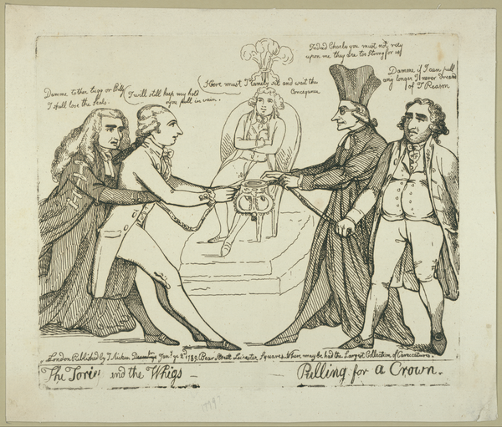
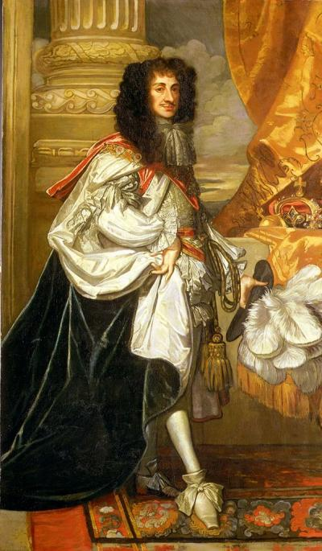
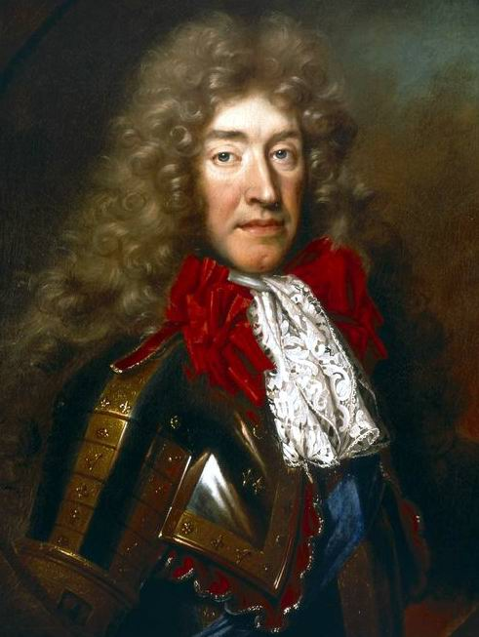
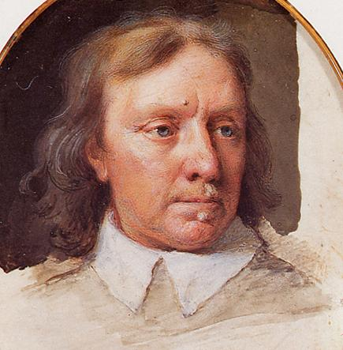
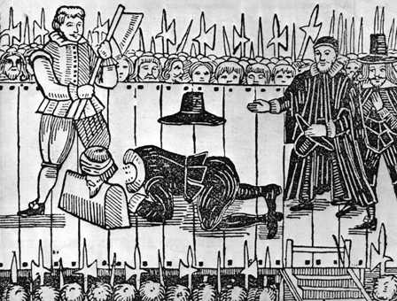
Development of the Rights of Englishmen
Oliver Cromwell
General during English Civil War, captured Charles I, tried him for treason against Parliament & executed him
The restoration of Charles II
Development of political parties/factions
Charles II had no legitimate children so his brother James (Catholic) inherited the throne
Whigs- opposed James, Tories- supported James

Slide 17
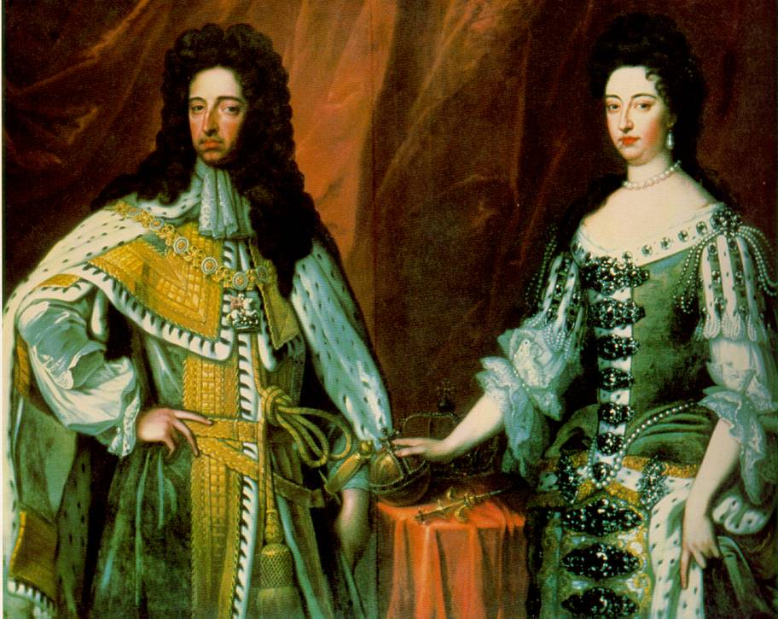
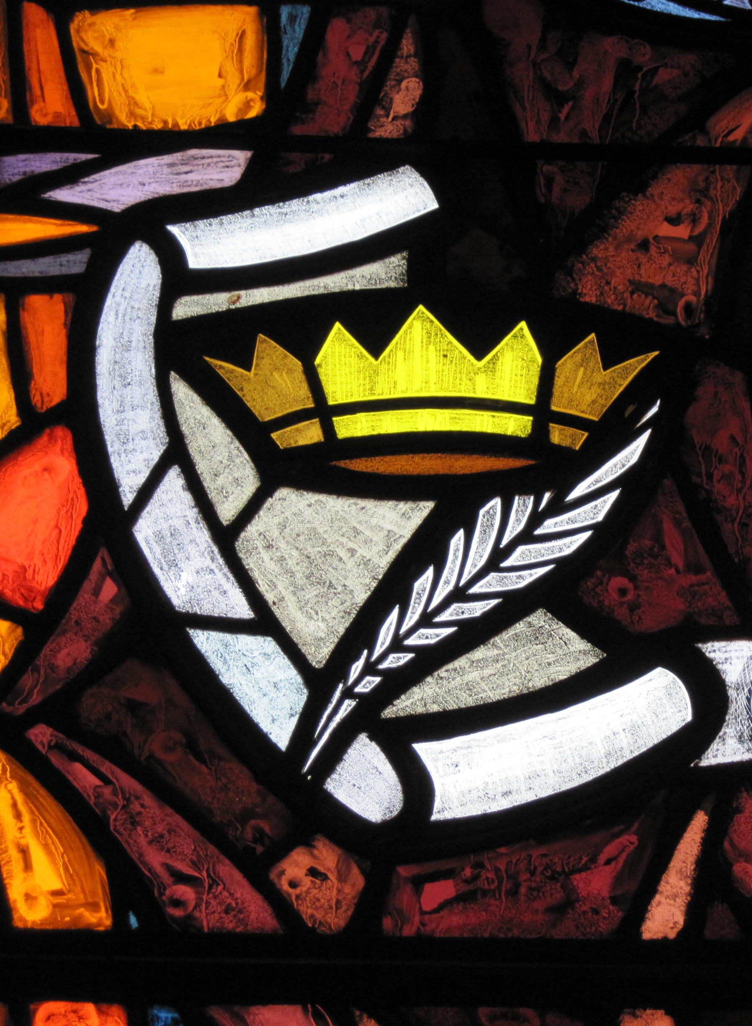
Glorious Revolution (William & Mary)
Opposition to James II led to asking his older daughter Mary & her husband William of Orange to overthrow the gov’t
James II fled to France & the takeover was bloodless
Increase of parliamentary power & the decrease of royal power
Coronation of William & Mary saw Parliament as a partner
England became a constitutional monarchy (laws limited the ruler’s power)
English Bill of Rights of 1689
Written to clearly define limits of royal power

